Slide 1
Hanover Branch Rail Trail
West Hanover

Slide 2
What is a Rail Trail?
Recreational path that re-uses an old rail bed
Access deep into nature on a smooth flat surface
Handicap accessible
Perfect for cycling
Safe place for runners
Quiet pathway to go for a walk
Connects different parts of town
Like a sidewalk without the cars

Slide 3
Where is the proposed project?
Begins on the Hanover/Rockland town line
Connects to the Hanover Branch Rail Trail which starts in Abington
Has existing trail connections to the Colby-Phillips Trails
Continues through West Hanover Square
Has an existing parking area on Hanover Street
Re-enters woods along Cushing Brook
Continues to the Drinkwater River crossing behind Ellis Field

Slide 4
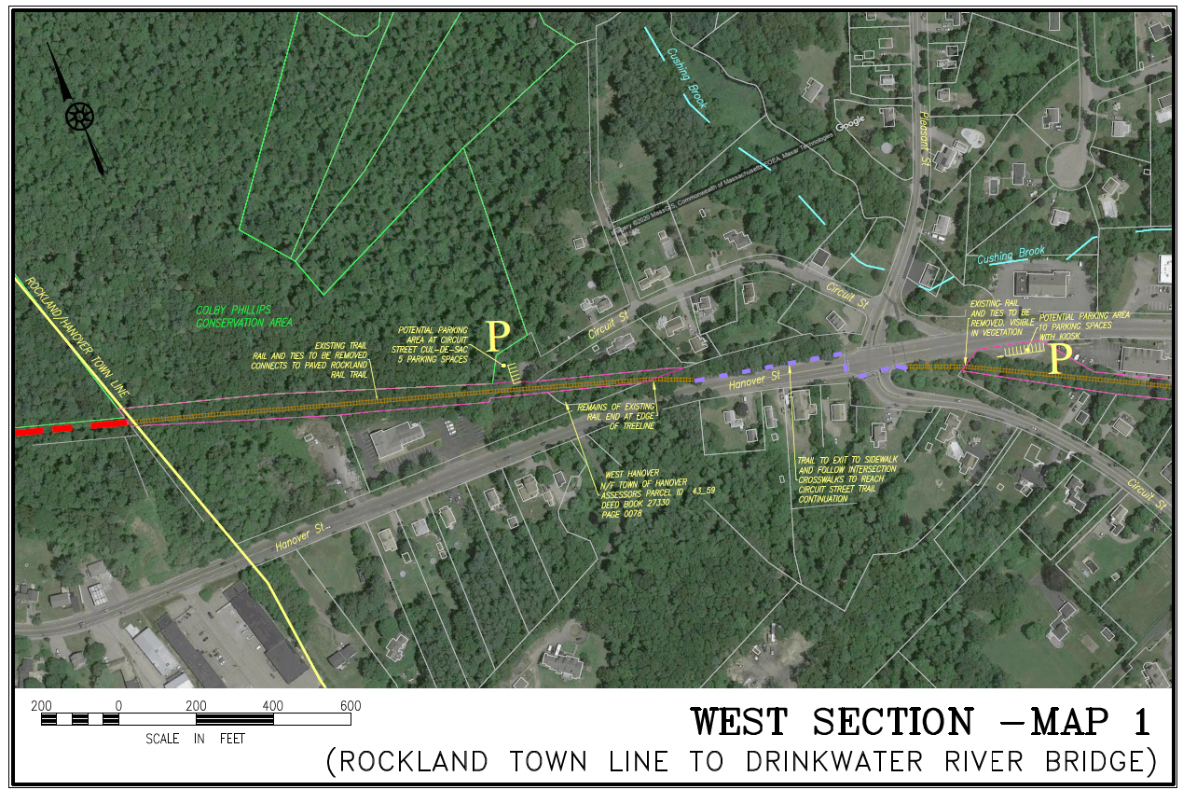

Slide 5
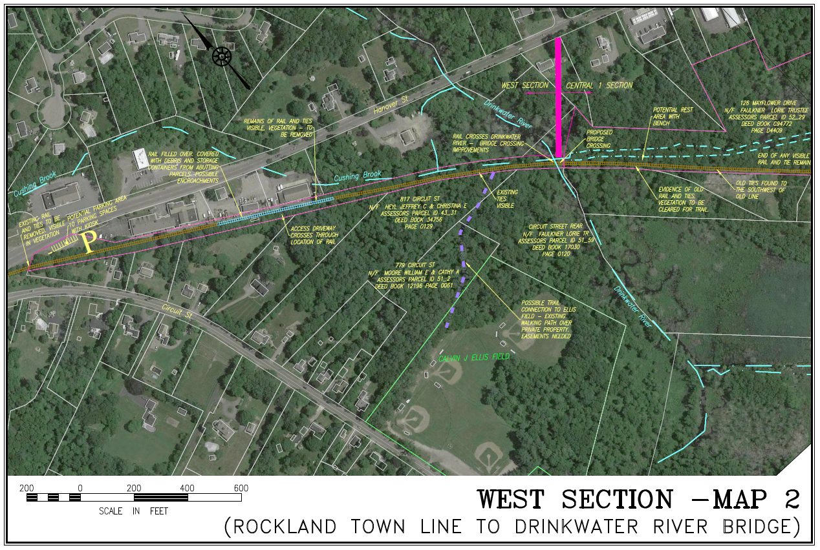

Slide 6
What’s the big idea?
Before
After

Slide 7
Who has trails like this?
Norwell – Norwell Pathway
Rockland – Hanover Branch Rail Trail

Slide 8
Who else has trails like this?
Cape Cod - Cape Cod Rail Trail
Plymouth – North Plymouth Rail Trail

Slide 9
How much does it cost?
Municipal Cost Estimate | $234,612
Public Procurement - High Estimate | $401,842
CPA Request | $250,000
MassTrails DCR Grant Request | $268,960
Masstrails Funding | To be awarded in June, 2021
 | Up to 80% of project cost
 | Costs reimbursed by grant award

Slide 10
Is this right for Hanover?
Do we have an existing rail bed? Yes.
Is there community interest in this project? Yes.
Will this benefit Hanover residents? Yes.
Will this benefit local businesses along the trail? Yes.
Do we have municipal support? Yes.
Can we afford this project? Yes.
Will this CPA allocation make our grant application stronger? Yes.
How should we vote on Article 24? Yes!

